Slide 1
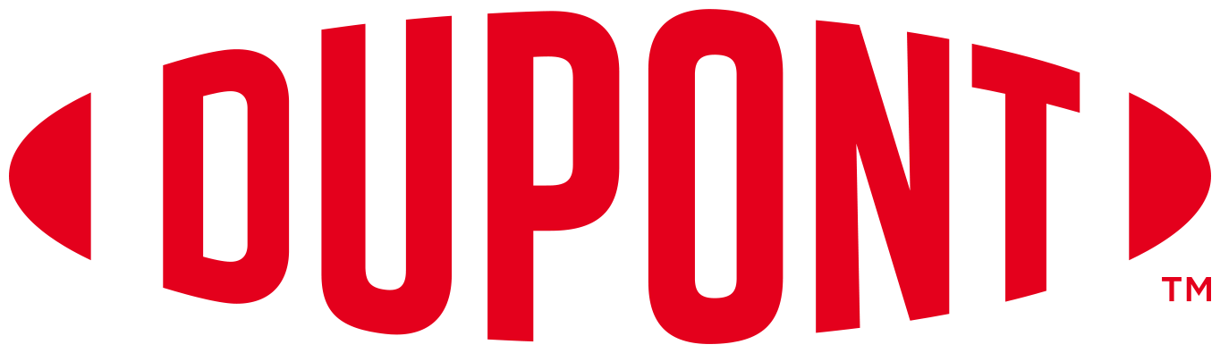
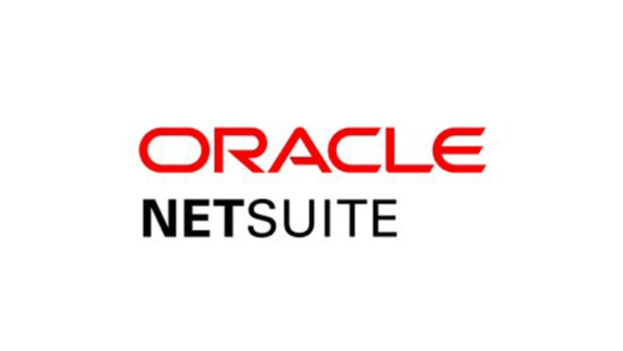
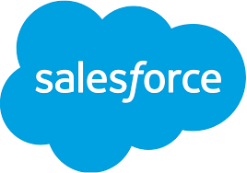
Dupont Water Solutions - Salesforce and NetSuite Integration
Goal
Dupont Water Solutions develops reverse osmosis systems for industrial water purification, reuse, and desalination. The company serves food and beverage, refining oil and gas, mining, power generation, automotive, and municipal industries.
Dupont Water Solutions needed assistance connecting their Salesforce and NetSuite applications. Prior to our integration, Dupont Water Solutions had a manual process to move closed won opportunities in Salesforce to sales orders in NetSuite. This manual process could lead to errors and delays. We designed an API to automatically populate key fields in NetSuite from Salesforce. We also provided a view in Salesforce that showed which opportunities were ready to convert to sales orders.
Result
Dupont Water Solutions immediately saw the benefits of this solution in automating the flow of opportunities to sales in NetSuite

